Slide 1


Secure Scuttlebutt
Chinmay Sanjay Deshpande
Reg. No. 170905432
Roll No. 50 Sec. D

Slide 2



What we will cover -
Motivation
Background Theory
Research Methodology
Results of the Research
Conclusion and Final Remarks
“Decentralization is
the Future”

Slide 3

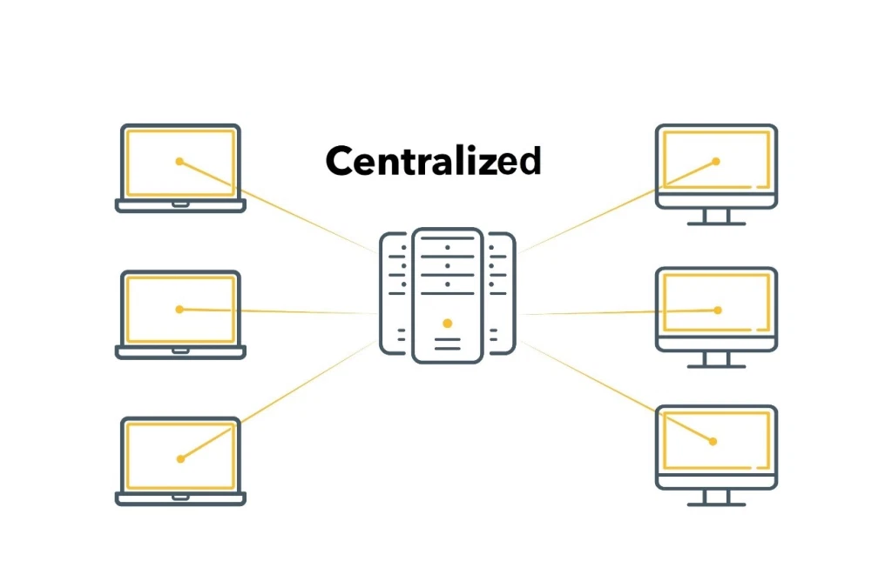
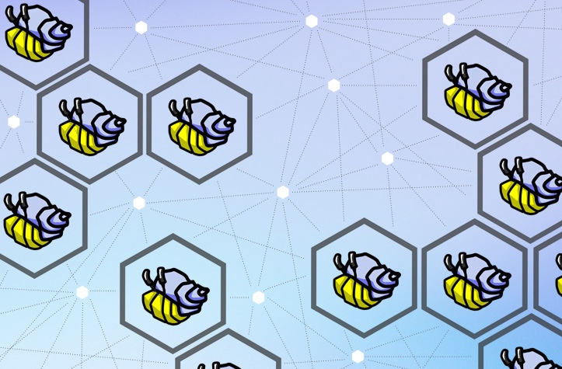
MOTIVATION
The Facebook–Cambridge Analytica data breach
The Traditional Centrally-Organized systems and Data Security & Integrity
A Decentralized approach–
Secure Scuttlebutt

Slide 4
Information-Centric Networking Approach and
Named Data Networking
Gossip Protocol
and the
Push Model
BACKGROUND THEORY
Selective Complete Log Replication and Subjective Reading
Secure Scuttlebutt Architecture and Protocol

Slide 5
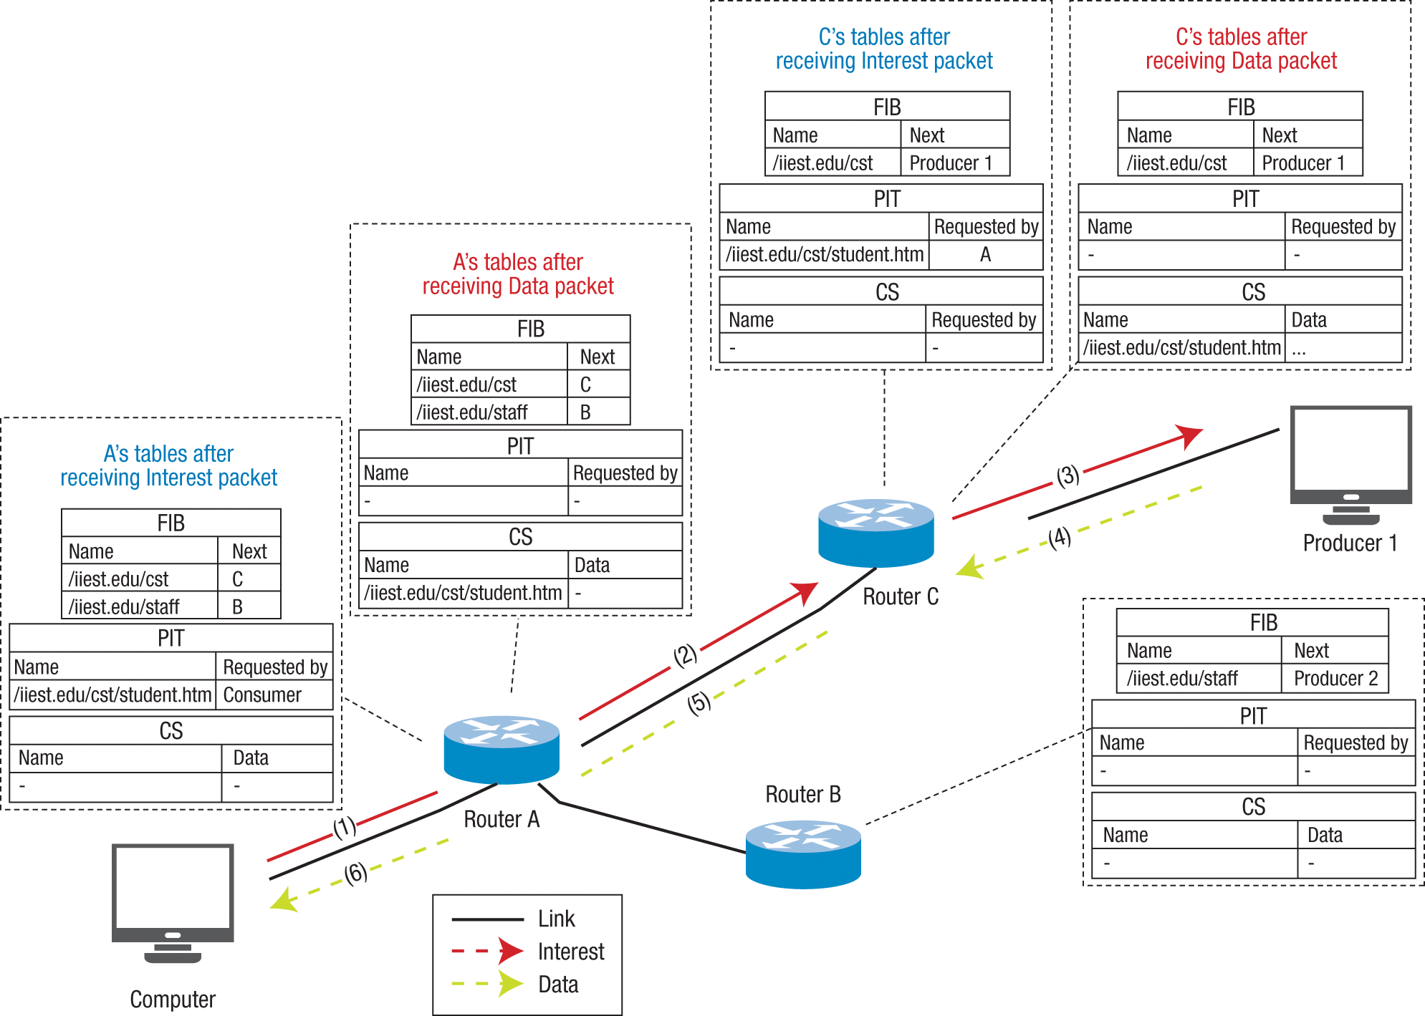
Information-Centric Networking approach and
Named Data Networking
Receiver-driven content retrieval model, or pull-model
A Hierarchical naming scheme
Objective is to optimize data distribution for large content providers

Slide 6
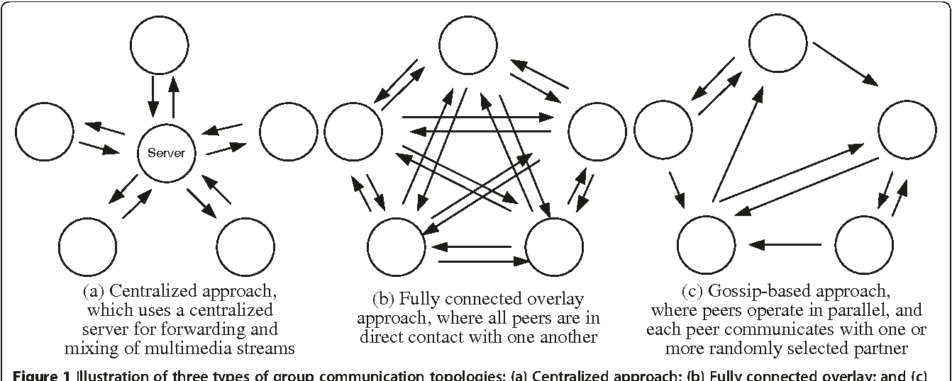
Gossip Protocol and the Push Model
Process for peer-to-peer communication
Logarithmic growth in expected time
Fault-tolerant and synchronous guarantee
Push Model and Named data streams
Reconciliation and use in Secure Scuttlebutt

Slide 7
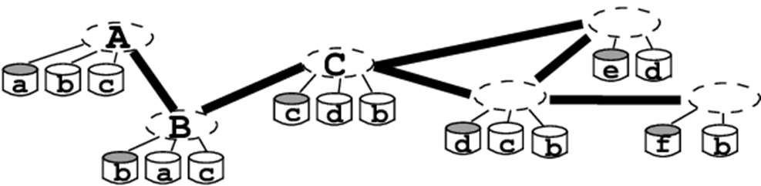
Selective Complete Log Replication and Subjective Reading
Concept of Social Graph and Append-only Logs
Subjective reader approach – different views for different users

Slide 8
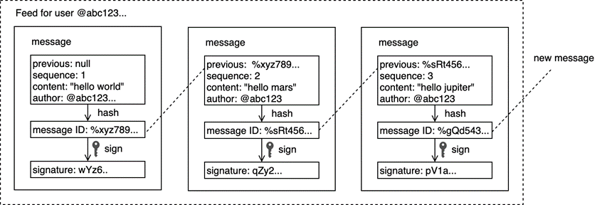
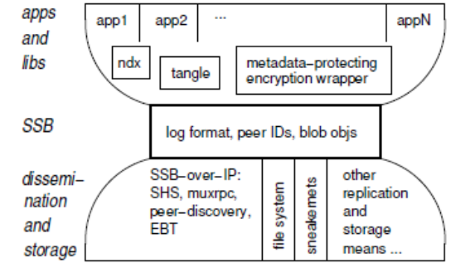
Secure Scuttlebutt Architecture and Protocol
Single-writer append-only logs
All nodes acting as relays
Keypair for each user
Log and Message structure and characteristics
Three independent protocol layers –
Application interface and data interpretation (top-layer)
Message format (middle-layer)
Data exchange mechanism by relays (bottom-layer)

Slide 9
The Research Methodology
Building Distributed Application over Secure Scuttlebutt Architecture and Protocols and the Analysis
Predicting Human Traits and Attributes by analysing Digital Behaviour – Facebook Likes

Slide 10
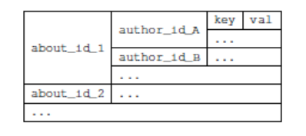
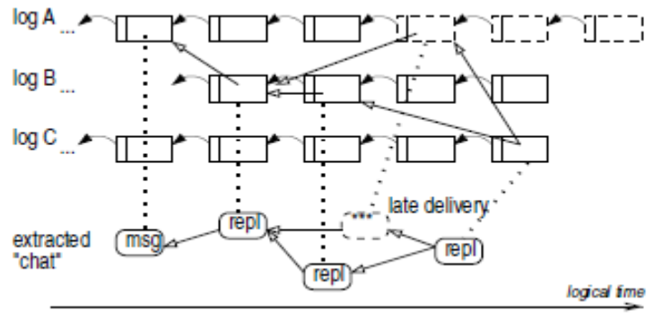
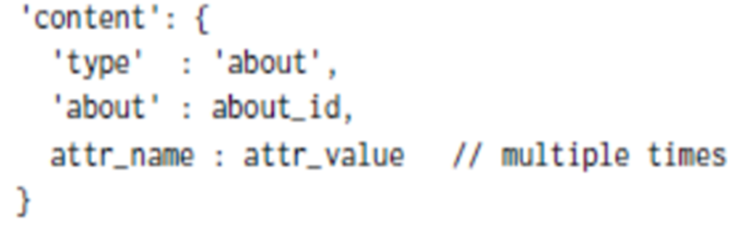
Building Distributed Application over Secure Scuttlebutt Architecture and Protocols and the Analysis
‘About’ - User Directory Database and Message Format
CRUD actions
Infrastructure-less Distributed Systems using log replication
Handling out-of-ordered logs while being updated – use of Timestamp

Slide 11
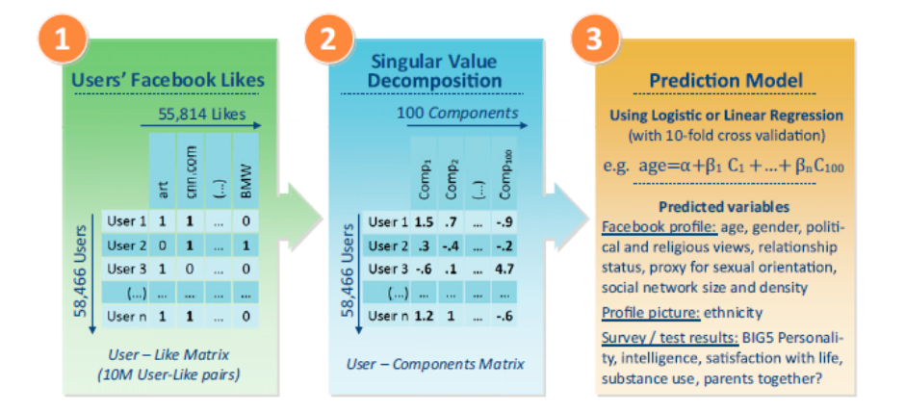
Predicting Human Traits and Attributes by analysing Digital Behaviour – Facebook Likes
Objective is to analyse with what accuracy we can predict a range of highly sensitive personal attributes
Some of the attributes chosen –
Age
Gender
Sexual orientation
Ethnicity
Religious and Political views
Intelligence
Use of addictive substances

Slide 12
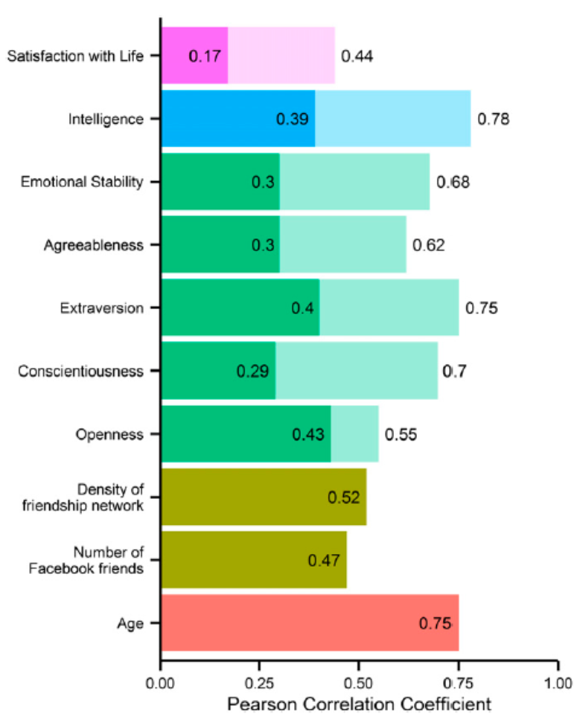
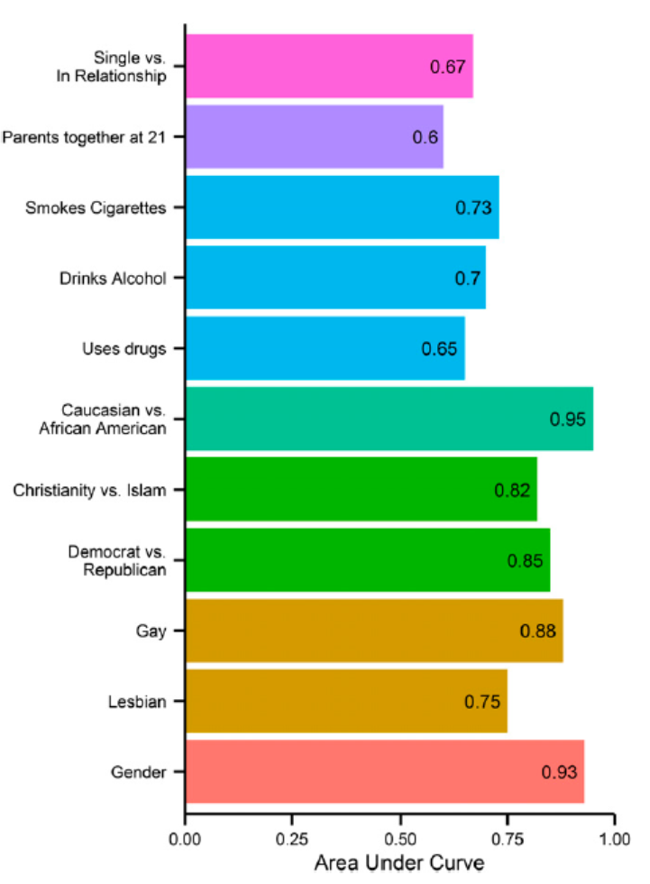
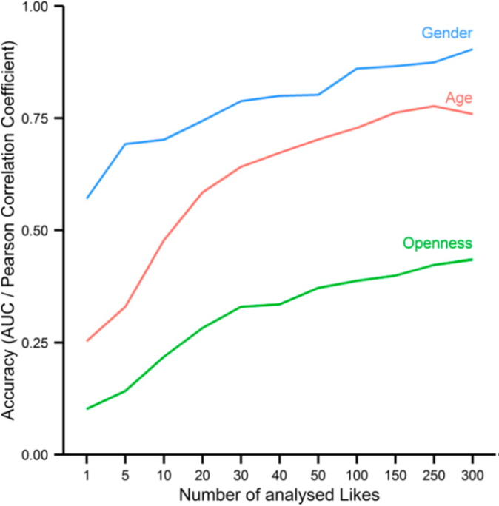
Result of the Research

Slide 13
Result of the Research
Analysing the Distributed Applications built over Secure Scuttlebutt showed the issues faced by Distributed Systems being resolved and why it is an attractive alternative-
It requires no run-time checks/configuration management
It deploys a cryptographic ID system
It maintains a social graph and provides flexibility in actual data dissemination strategy
Every peer is a publisher/author by design
It is a distributed system with inherent high resilience

Slide 14
Conclusion and Final Remarks
A Decentralized Approach
Secure Scuttlebutt as an Alternative and Future Challenges
Need for a net neutral, unbiased and transparent system
An answer to government censorship and monopoly posed by the giant tech companies
A simple, efficient and versatile information-centric service abstraction
Certain challenges, which present opportunities to improve

Slide 15
Secure Scuttlebutt
THANK YOU
Chinmay Sanjay Deshpande
Reg. No. 170905432
Roll No. 50 Sec. D

